Slide 1
Online Reputation Management PPT 07A
MIS 7710
Notes:
Welcome to the course “Web Analytics for Business”. This is Powerpoint 1 A. You have a total of 4 powerpoints to go through.
I am your instructor Avanti Pandit.

Slide 2
Brand - refresher
A brand is anything—a symbol, design, name, reputation —that separates and identifies one thing from another
Corporate brand- Golden Arches for McDonald,
Product brand – Activision’s Guitar Hero
Personal brand – Donald Trump
https://www.donaldtrump.com/
https://www.facebook.com/DonaldTrump/
https://twitter.com/realdonaldtrump

Slide 3
Online Reputation Management (ORM)
What is it?
Understanding, managing and influencing the perception of an entity online.
Where you have social media and digital assets, you MUST have a good handle on reputation management and always be aware of mentions of your business (or industry and competitors) as this may explain variations on website traffic data.

Slide 4
Track, analyze and optimise
Whenever you link your business to any social media (or even if you don’t) - create a process for tracking and response
(part of ORM)
If you have unexplained variations in your web traffic analysis this is one area that may have contributed!!

Slide 5
Importance of ORM
A company’s reputation has been shown to make a difference to its bottom line.
“brands now control only 66% of their brand touch points” – McKinsey Quarterly
“…social media means has largely transferred that power to consumers. (Forbes.com, Sep 8, 2014)

Slide 6
Why have companies lost control of their brand?
Inexperience in managing Social media
Someone has a negative experience and mentions it
Someone has a positive experience and mentions it
Tracking comments before it gets out of control
new ways to strengthen relationships
People are relying on the internet (UGC) for their information
News of bad customer service reaches more than twice as many ears as praise for a good service experience.
Source: White House Office of Consumer Affairs
Notes:
News of bad customer service reaches more than twice as many ears as praise for a good service experience.
Source: White House Office of Consumer Affairs
https://www.helpscout.net/75-customer-service-facts-quotes-statistics/

Slide 7
The power of managing WOM
Those who viewed Negative WOM decreased total spending by 12 percent and purchase frequency by 5 percent
-BUT-
Those who posted NWOM and then experienced the value of the brand (that may mean brand intervened in some way and resolved their issue), they increased spending by 58 percent and purchase frequency by 16 percent.
https://spiegel.medill.northwestern.edu/studies/online-negative-word-of-mouth.html

Slide 8
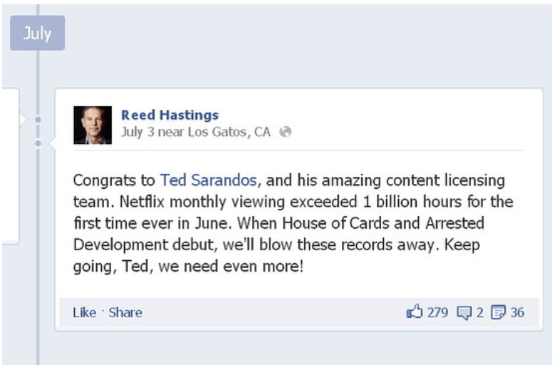
Social media impact on markets
Social media has been observed to have a definite impact on the markets
2016: The stock prices for Netflix increased by 16%, going from $70.45 to $81.72 when Reed Hastings, the CEO commented on Facebook about online viewing breaching the one billion hours mark.
http://www.forbes.com/sites/quora/2013/09/10/does-social-media-affect-capital-markets/#d860f2456f9c
https://financehacker.org/how-social-media-affects-stock-prices/

Slide 9
ORM – How it works
MONITOR –
Listen to conversations; monitor all mentions
Use free services such as Google alerts, email alerts, RSS feeds to keep informed
Use paid services such as BrandsEye that collect mentions from all over the internet
LEARN, MEASURE, EVOLVE
Aggregate type of mention, source, credibility, influence, action
MANAGE THE RESPONSE
Comment when it’s appropriate, listen with interest, be polite, respectful and add value wherever possible
MAXIMIZE – Evolve
use the data to help make statistically supported decisions about the future

Slide 10
Monitor
WHAT?
Monitor all mentions of you, your company, your competitors
Includes blogs, news, Twitter, Youtube, job listings, forums etc…
HOW?
Listen to conversations
Use feed readers
Use alerts
Join forums, become a follower
Use free services - RSS feeds and alerts to keep informed
Google alerts
Social Mentions search engine
Use paid services such as BrandsEye, Trackur, ViralHeat, Sprout Social

Slide 11
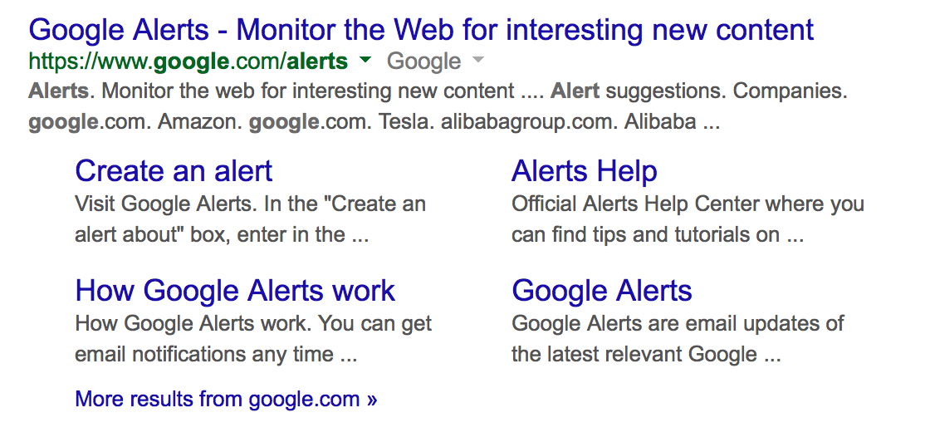
Google Alerts https://www.google.com/alerts

Slide 12
ORM and Google Analytics
Managing Organic Traffic spikes or drops with GA Custom Alerts
If you notice a change in your web traffic pattern that is unexplained by any of your campaigns how would you investigate and analyze it?
There could be any number of reasons for this:
Search engine update
New competition
Or….a story posted about your company or a social media post or perhaps even word-of-mouth rumors that are gaining traction
----- this might be causing people to do search for your brand’s name and possibly go to your site to investigate what the conversation is about.
A good practice is to also add a custom alert in analytics
Source:https://www.bounteous.com/insights/2014/06/16/using-google-alerts-and-google-analytics-online-reputation-management/

Slide 13
How to set up custom alerts in GA (UA)
Here is a good article on how to set up custom alerts.
Since your term project business is new, I don’t think it is necessary to set up extensive custom alerts though I did want you to be aware that this feature exists in GA.
Its an interesting idea and very useful!
https://bit.ly/3sJsIrE
Check out custom alert #2 & custom alert #4 – change in organic traffic and change in social traffic

Slide 14
ORM keywords
Use keyword matches
Track mentions of yourself, staff, products, industry, competition
Use operators
Broad match (Apple Computers) – maximum results
Direct match (“Apple Computers”)
Inclusive match (Apple+Computers)
Exclusive/negative match (Apple – fruit)
“Apple Computers”+ “steve jobs” - fruit

Slide 15
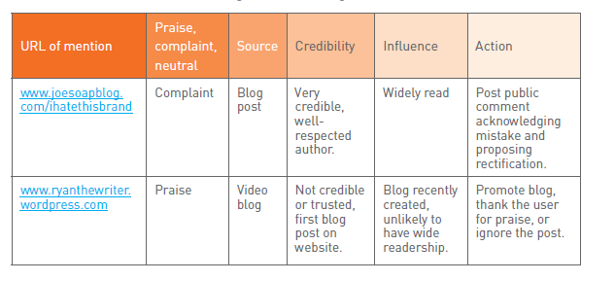
Learn, Measure, Evolve

Slide 16
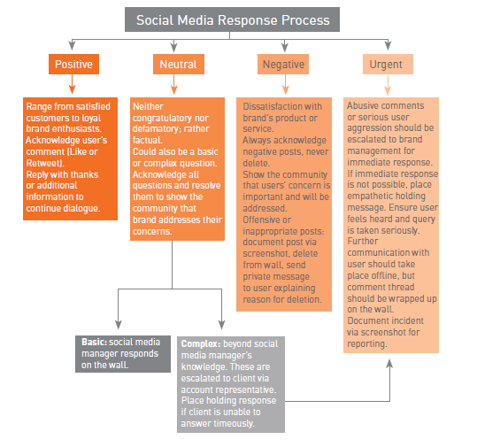
Set up a
response strategy
Comment when
appropriate
Listen with interest
Be polite
Add value where possible
Promote the positive image!!
Brainstorm ways to do this!

Slide 17
Continuous improvement - Evolve
Narrow the gap between business offering and stakeholder expectation
Use the data collected to help make statistically supported decisions about the future.
This will reduce the negative perception

Slide 18
SEO and Online reputation management (ORM)
A savvy SEO strategy will make use of digital assets like social media comments, links, whitepapers, youtube videos, press releases etc for strengthening the position of POSITIVE mentions in the search engine results pages.
Encourage activities that provide positive mentions so that a brand ‘owns’ the top results page for searches for their brand. Any negative mentions should be pushed down out of sight and replaced by new mentions!
RECLAIM CONTROL OF THE BRAND – BE ALERT!

Slide 19
Interesting Article on ORM - debate between privacy and freedom of speech in Europe
Online reputation: Spain - landmark case - fighting to clean up image
http://www.newsweek.com/man-who-sued-google-be-forgotten-252854
http://www.karenhenry.com/blog/online-reputation-right-forgotten-ruling-good-news (2014)
https://www.bbc.com/news/technology-49808208 (2019)

Slide 20
Manage the response
Positive
Negative
Comment when appropriate
Listen with interest
Be polite
Add value where possible

Slide 21
Promote the positive image!!
Own the SERP!
Brainstorm ways your social assets and your posts can help generate and strengthen your brand awareness!

